Slide 1


Chess Game Analysis Using PySpark and RDDs
BY AMAN JAIN
METCS 777
08/10/2024

Slide 2
INTRODUCTION
The goal of this project is to analyze chess games using big data technologies, including RDDs and PySpark, to get deeper insight into player strategy, game dynamics, and performance trends.
Scope of the Project
Preprocessing and loading a sizable collection of chess matches.
Exploratory Data Analysis (EDA) to understand the dataset.
Processing data with PySpark RDDs.
Predicting game results using machine learning algorithms.

Slide 3
Dataset Description
The dataset, saved in Google Cloud Platform, contains data from numerous chess games, providing valuable insights into player performance, game dynamics, and strategy.
The dataset includes key fields such as hash, plies, FEN, hascastled, assess, and outcome. It also includes the board state, has cast, assess, and outcome, with 1.0 representing a win, 0.5 a draw, and 0.0 a loss.

Slide 4

PySpark and RDDs
Introduction to PySpark and RDDs: PySpark is an open-source analytics engine for Apache Spark, designed for handling large data sets. It offers high-level APIs in Java, Scala, Python, and R, and an efficient execution engine. Its fundamental abstraction is Resilient Distributed Datasets (RDDs), simplifying distributed data processing..
Setup and Configuration: Increased driver maxResultSize and executor memory settings, using Google Cloud Platform (GCP) for storage and processing. Google Cloud Storage (GCS) stores a massive collection of chess games, while Google Dataproc is a managed cloud service for running open-source data processing frameworks like Apache Spark, and Google Compute Engine (GCE) provides customized virtual computers for Spark applications.

Slide 5

Exploratory Data Analysis (EDA)
Purpose of EDA:
Summarize key attributes.
Look for outliers, missing values, and abnormalities.
Find underlying linkages and trends.
Techniques Used:
Descriptive Statistics.
Missing Value Analysis.
Correlation Analysis.
Visualization Techniques.

Slide 6

Key Findings
Distribution of Evaluation Scores: Range of ratings given to various records.
Relationship between Attributes and Evaluation Scores: How assessments are impacted by different attributes.
Distribution of Results: Frequency and distribution of various outcomes.

Slide 7
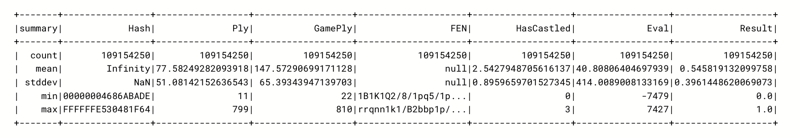
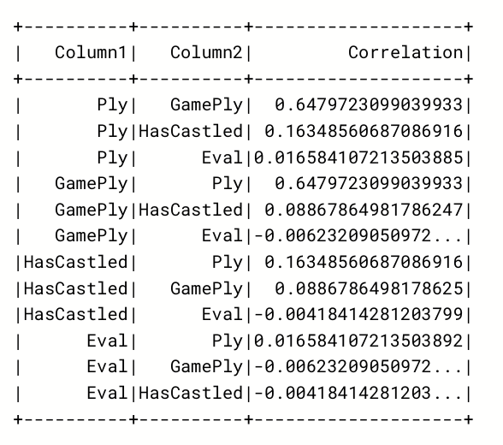
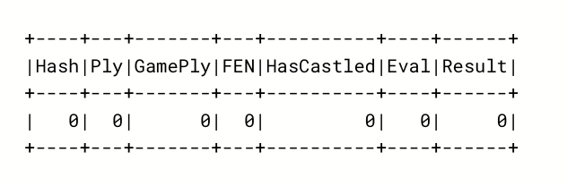
Results
Data Description :
Missing Values :
Correlation Matrix :

Slide 8
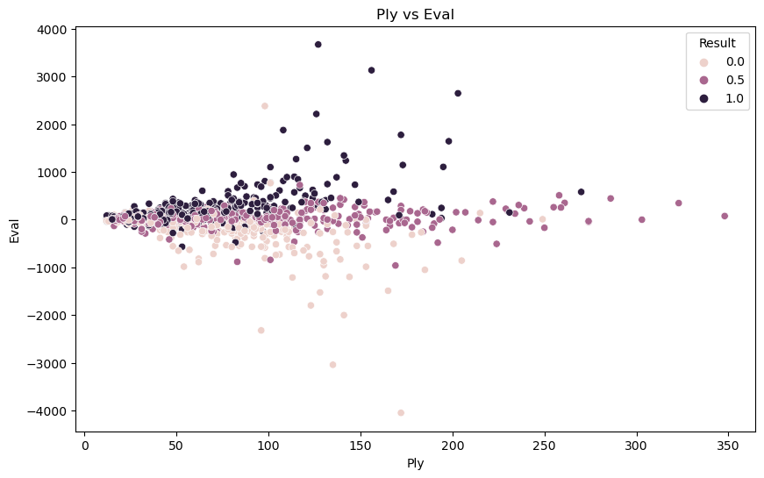
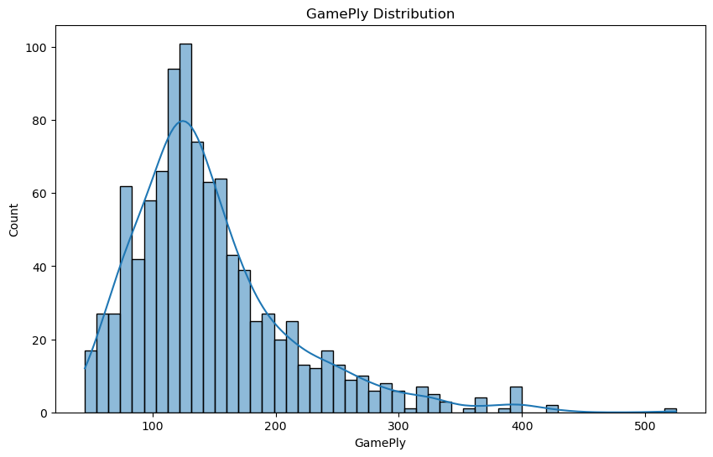
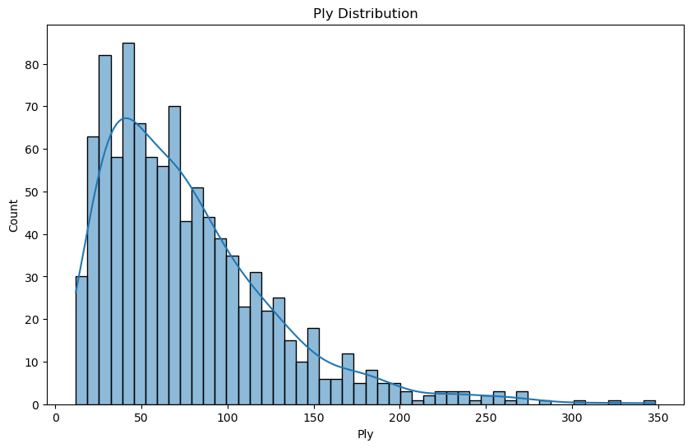
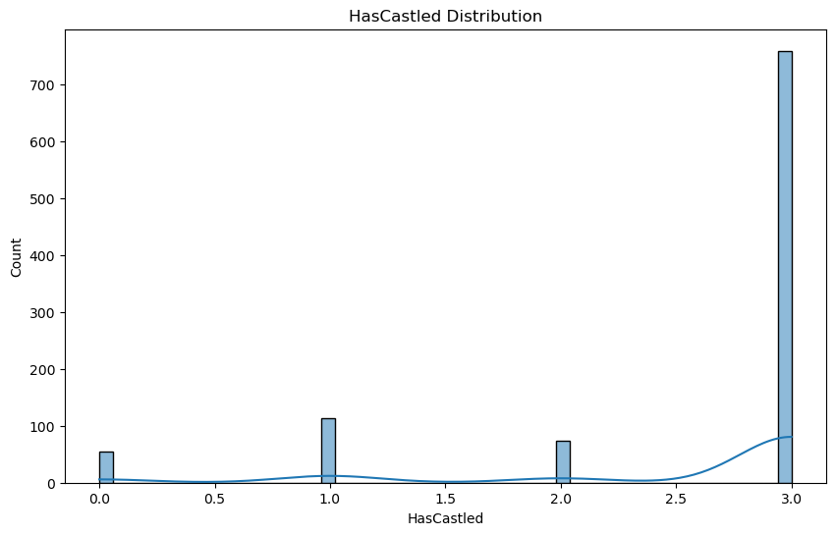
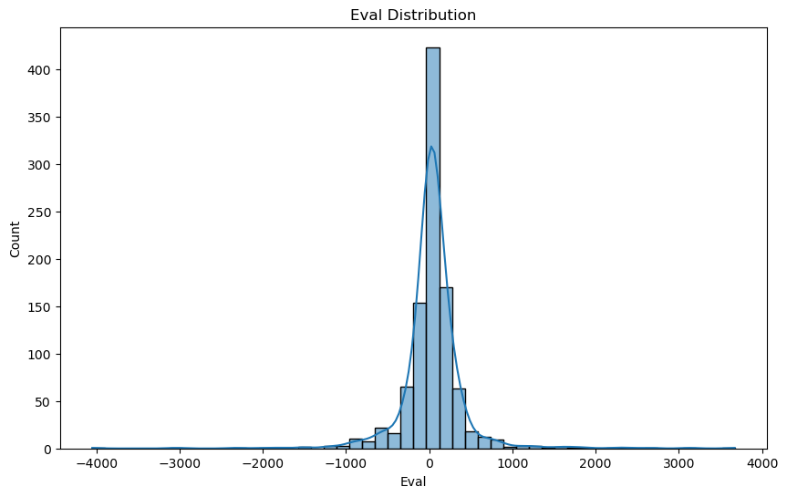
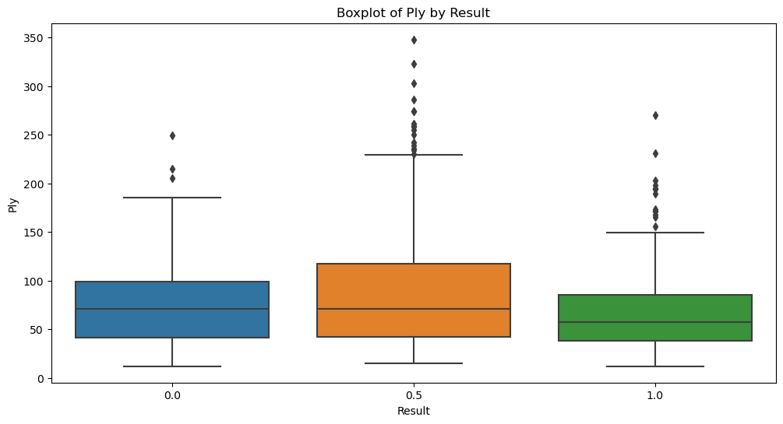
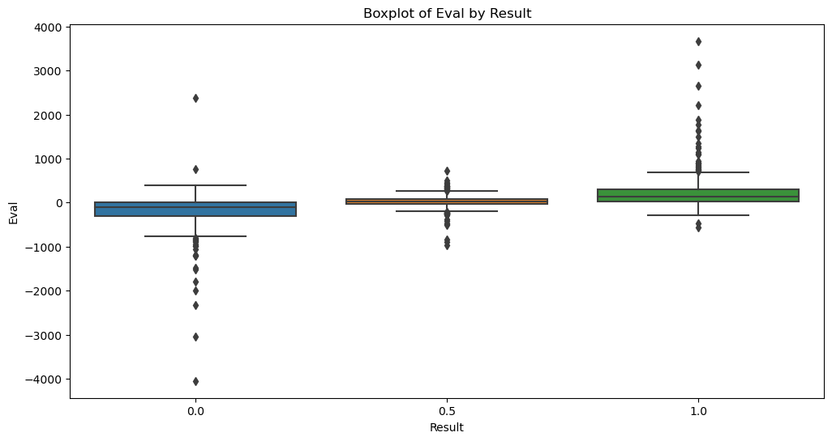
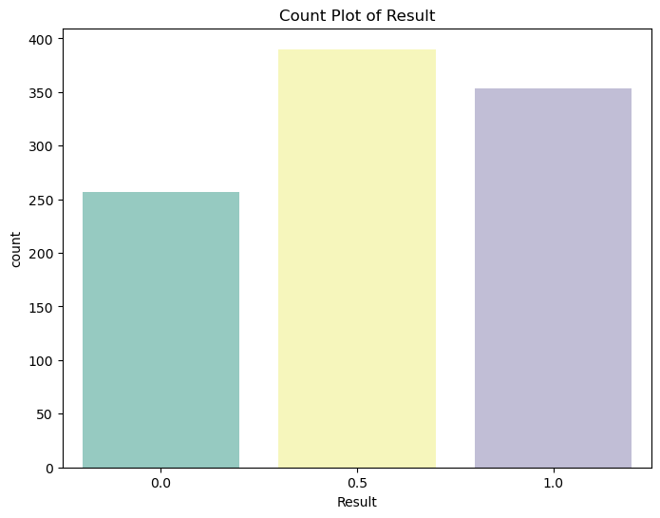
Visualization (EDA)

Slide 9
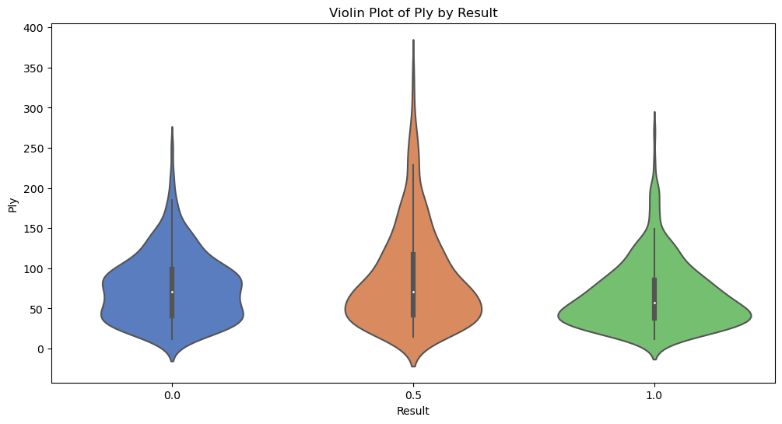
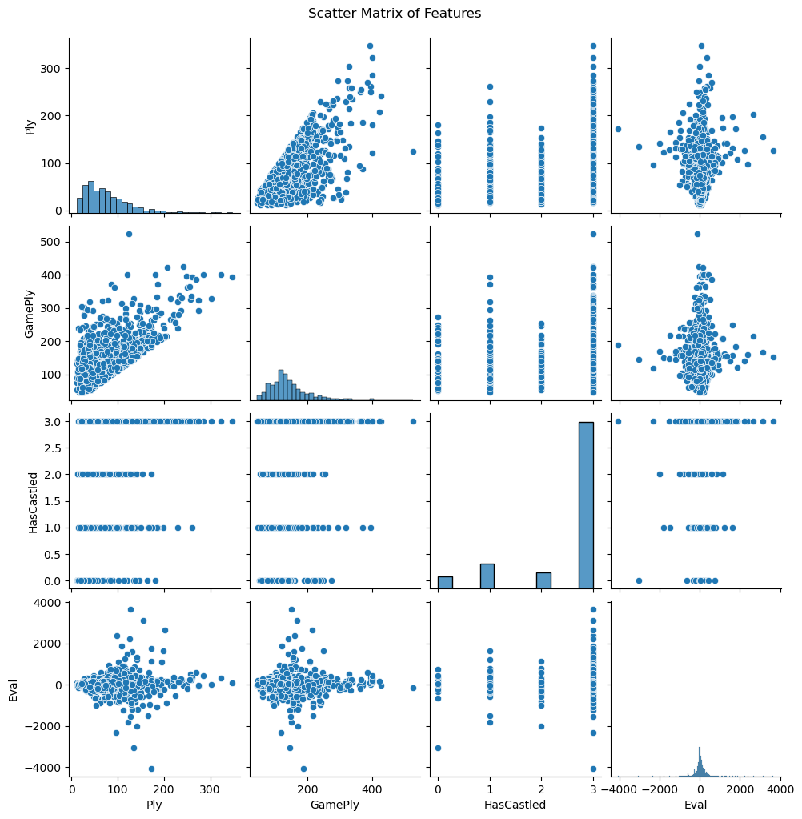
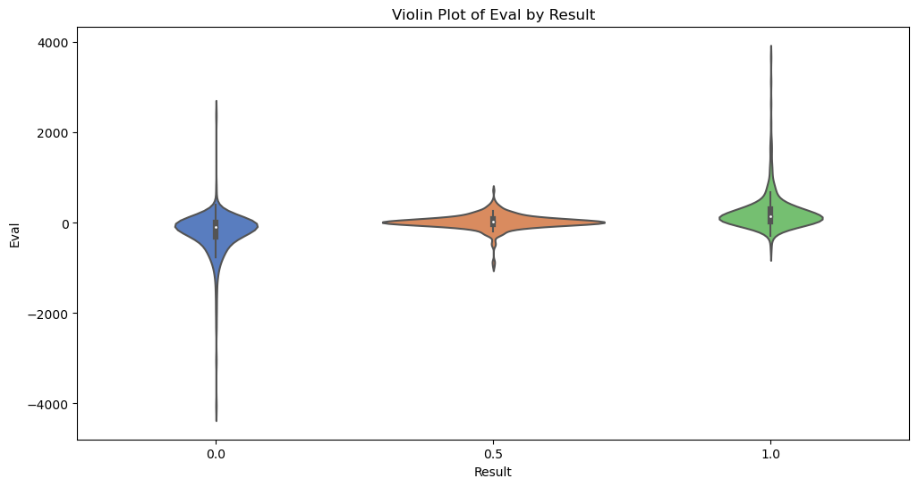

Slide 10
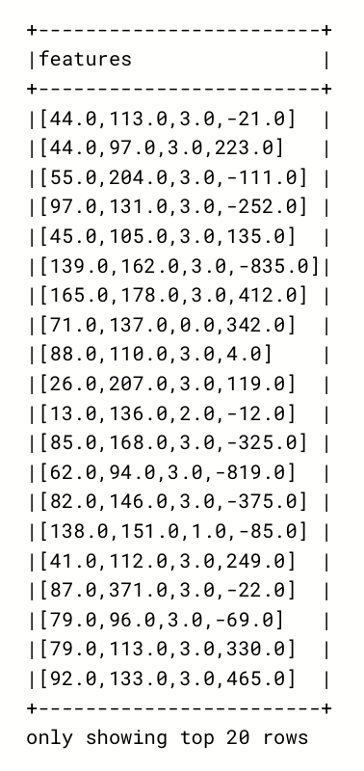
Data Processing with RDDs
Loading Data: Dataset stored in GCS for quick access and processing.
Transformations and Actions:
Filling missing values.
Assigning columns to proper data types.
Computing summary statistics and correlations.
Assemble Tasks: Combining features into a single vector column, creating labels for machine learning tasks.

Slide 11

Machine Learning Analysis
Feature Engineering: Compiling relevant features into a single vector column.
Model Training and Evaluation: Logistic Regression, Decision Trees, Random Forests; Metrics: Accuracy, F1 Score, Precision, Recall.
Results: Confusion Matrices, Feature Importance.

Slide 12
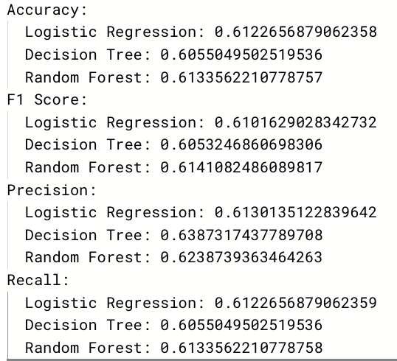
Results and Discussion
Key Findings:
Logistic Regression: Baseline model, reliable but less sophisticated.
Decision Tree: Insight into feature importance.
Random Forest: Best performance, balanced accuracy and interpretability.
Interpretation: Random Forest provided the best balance of accuracy and interpretability.

Slide 13
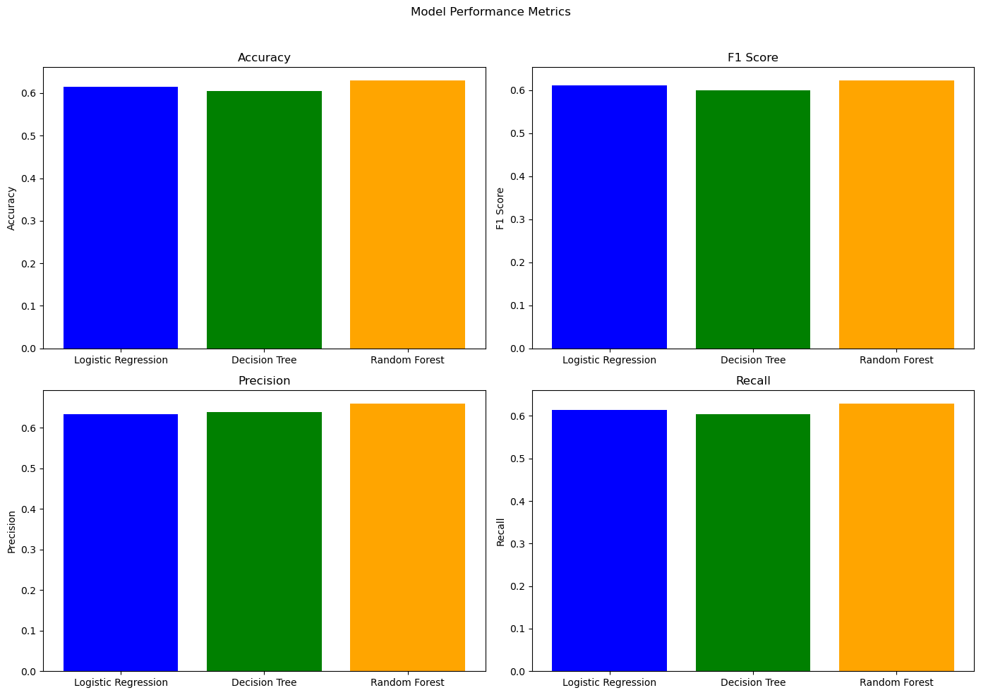
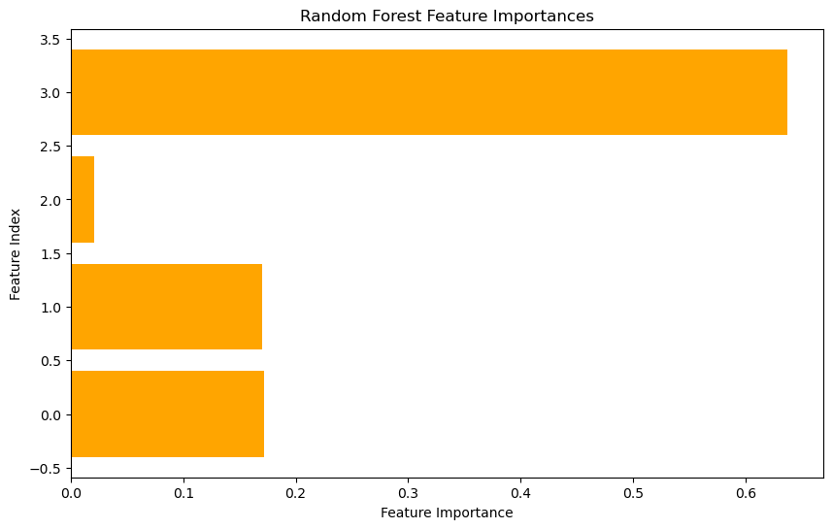
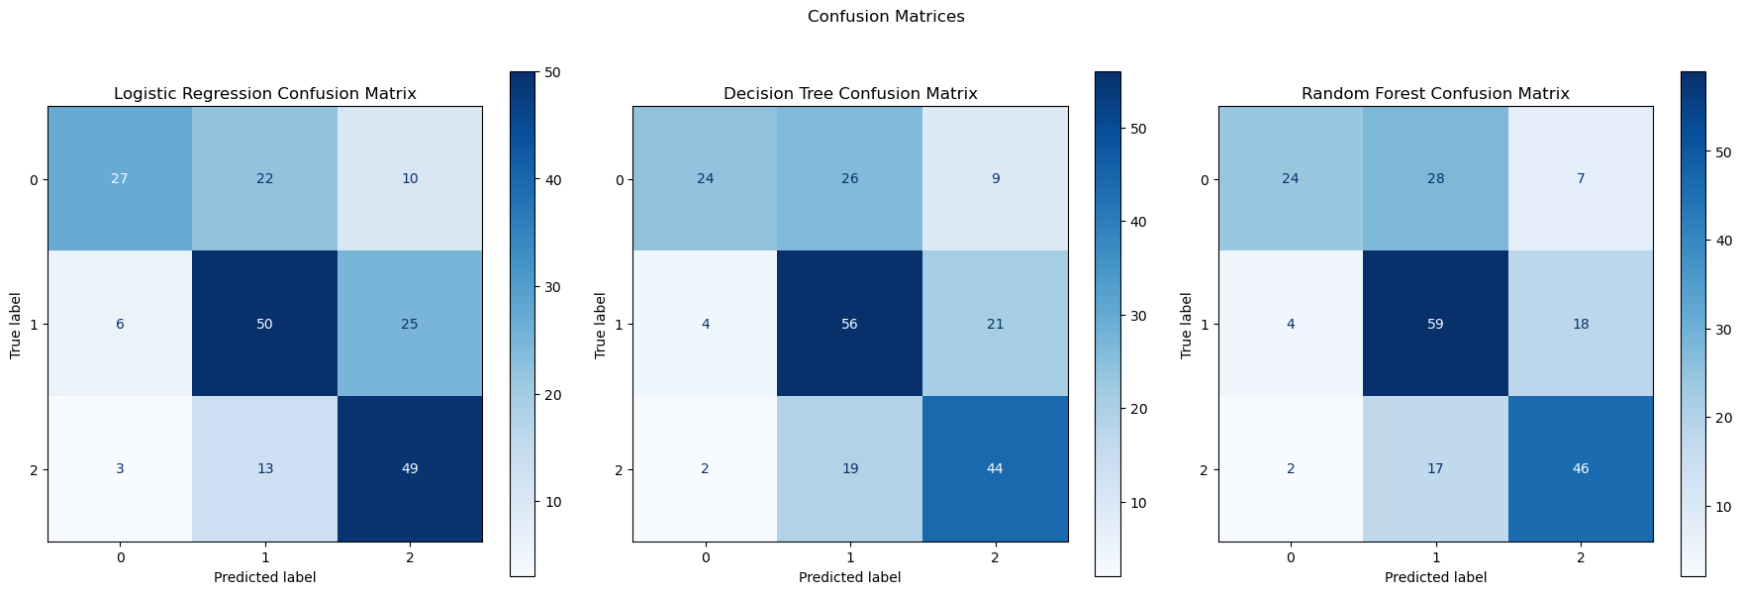
Visualization

Slide 14

conclusion
Summary:
Data Loading and Preprocessing.
EDA.
Data Processing with RDDs.
Machine Learning Analysis.
Results and Insights.
Future Work:
Detailed Performance Analysis.
Incorporating Additional Features and Data Sources.
Exploring Advanced Machine Learning Models.

Slide 15

Thank you

